Slide 1
Molecular Biology Biol 480
Lecture 14 February 19th, 2019

Slide 2
Announcements/Assignments
Keep reviewing lectures every day. Use the lecture summary tool, if it works for you.

Slide 3
Where were we…
DNA replication in eukaryotes
Multiple start sites
Asynchronous along the chromosome during S- phase
Processivity of DNA replication/DNA polymerases (How fast do they move and replicate DNA—what affect processivity)
What happens to nucleosomes during replication?
Some DNA synthesis is for DNA repair

Slide 4
ARS (Eukaryotic/yeast replication origins) not only act as sights for initiation, but control the timing of DNA replication.
A complex of 20+ proteins called the prereplication complex (pre-RC) binds to ARS sequences starting in G1.
The presence of the pre-RC complex at an origin is necessary for replication to occur and DNA pol will not bind without it.

Slide 5
Once DNA pol starts replication, the pre-RC disassembles. That way, DNA pol can tell the difference between unreplicated DNA (which would have pre-RC bound and newly replicated double stranded DNA (which should not).
Pre-RC associates with several of the key proteins associated with cell cycle progression. (Cyclin E and Cyclin-dependent kinase CDK 2)

Slide 7
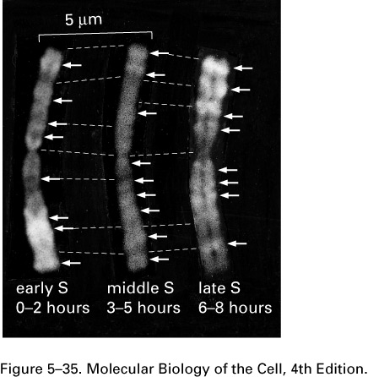
The arrows point to regions of the chromosome that are replicating at different times during S-phase

Slide 8
Major points?—Focus on the first 2 pages, primarily.
Minireview
Split Decision: What Happens to Nucleosomes during DNA Replication?*
Published, JBC Papers in Press, January 21, 2005, DOI 10.1074/jbc.R400039200
Anthony T. Annunziato‡

Slide 9
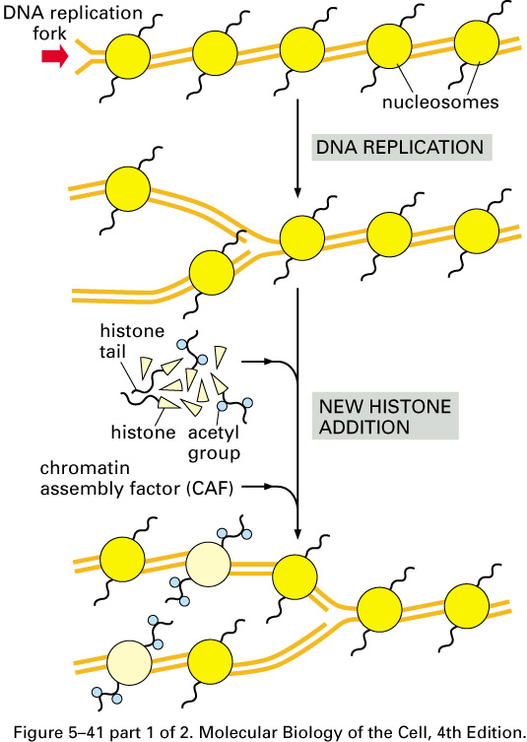
When newly made histones are assembled into new nucleosomes after replication, a complex called chromatin assembly factor is required to deposit the new histones on the newly made DNA strands

Slide 10
Keep in mind we have discussed epigenetic modifications and their “heritability”
So…not only do nucleosome reassemble on the newly synthesized DNA/Daughter DNA molecule, the histones must be modified the same as they were in the parent DNA molecule!

Slide 11
Eukaryotic DNA polymerases Read about them
5 different DNA pols work to replicate eukaryotic nuclear DNA, whereas 1 DNA pol repilcates DNA in mitochondria.
Table 11.5. Read about the roles of each.

Slide 12
DNA repair
DNA polymerases are active at times other than S-phase.
Several types of DNA repair require replacement of short or even extensive regions of DNA. Although a host of enzymes may be used to recognized, remove, and prepare for DNA repair, if the fix requires new DNA it is always synthesized by a DNA polymerase. Gaps in DNA strands are repaired by DNA ligases.

Slide 13
Using what we’ve learned about DNA replication…
In vitro replication:
We have figured out several ways to synthesize DNA in the laboratory using DNA polymerases.
Essentially any enzyme can be put to work in a test tube if you supply it the conditions it needs to be active in a cell.
We call these processes “cell-free” experiments if only extracts or purified components of cells are used.

Slide 14
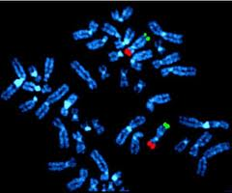
Examples…
DNA can be synthesized for many purposes.
Use as probes in hybridization.
Use as primers
Copying DNA for sequencing. (We’ll come back to details here)
Copying RNA into DNA form for stability (cDNA)

Slide 15
Depending on the replication job, scientists may use just the part of a DNA polymerase with the needed activity.
For example biotechnology companies sell purified E. coli DNA polymerase I but remove part of the protein which is either not necessary or which might mess up the synthesis.

Slide 16
Klenow fragment…
Description:
DNA Polymerase I, Large (Klenow) Fragment is a proteolytic product of E. coli DNA Polymerase I which retains polymerization and 3'→ 5' exonuclease activity, but has lost 5'→ 3' exonuclease activity (1). Klenow retains the polymerization fidelity of the holoenzyme without degrading 5' termini.

Slide 17
Polymerase Chain Reaction (PCR)
We will cover PCR in detail later, but a reminder, that PCR is in vitro DNA replication.
Like other forms of in vitro DNA replication, DNA polymerase is required, but some of the helper proteins are not. The activities of these proteins can be mimicked by experimental conditions—primarily using heat to separate template strands.
(Replication occurs in rapidly changeable temperature conditions.)

Slide 18
PCR
Selected regions of a DNA template are copied by using primers of specific sequence. DNA polymerase automatically synthesizes DNA by extending the primer.
New DNA can become template for successive rounds of replication. (chain reaction)
PCR amplifies (makes lots of copies) of a specific region of DNA.
Because each new DNA molecule becomes a template for the next round, the amplification is exponential.

Slide 19
Brief review—in vitro DNA replication using PCR

Slide 20
A twist on DNA replication
Inhibiting DNA replication for the purpose of killing cells. What? Why?
Many diseases are the result of abnormal cell division resulting in accumulation of unwanted cells.

Slide 21
Examples?
Cancer
Autoimmune diseases or inappropriate immune responses

Slide 22
How does this work?
As you’ve heard, our cells have built in mechanisms for suicide if cell health is compromised. Recall any examples?
One of the major triggers for apoptosis is DNA damage. DNA damage can be detected at various points in the cell cycle---called cell cycle check points.

Slide 24
Many genes/proteins are involved in this fail-safe---many of which are activated by a master regulator, called p53

Slide 25
The main point here is that failure to safely or completely replicate DNA is a semi-specific way of killing rapidly dividing cells.
4 major mechanisms---Things that can happen to the cells.

Slide 27
Autophagy---recycling of cellular components in preparation for cellular crisis.
Senescence---Cellular pause---the cell does not die, nor does it continue to divide.
Necrosis---cell death that is rapid, disorganized, uncontrolled.
Apoptosis---genetically regulated, “organized” cell death.

Slide 28
There are several strategies for inducing DNA damage or disrupting DNA replication, built into drug design.

Slide 29
Inhibitors of nucleotide synthesis--Methotrexate
Inhibitors of DNA polymerase (repair activity).
Topoisomerase inhibitors--Etoposide
Agents that damage the DNA template--Platinum

Slide 30
Other applications---disrupting DNA synthesis…
Targeting genome replication in infectious disease.
Although we have said that DNA replication is virtually the same in prokaryotic and eukaryotic cells (and in viruses), minor differences allow another semi-specific therapeutic approach using DNA replication.

Slide 31
Some viruses replicate their genomes utilizing their own polymerase (rather than that of the host cell).
A great example in HIV.

Slide 32
HIV utilizes its own reverse transcriptase to copy its genome of RNA into DNA.
A class of modified nucleotides was designed to specifically inhibit the activity of this enzyme and/or the process of reverse transcription.

Slide 33
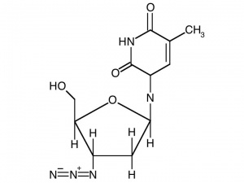
AZT
The best example is the development of nucleotide analogs such as the one that became the HIV inhibiting drug AZT (Azidothymidine)
How might AZT inhibit
DNA synthesis? Check it
out, chemically.

Slide 34
AZT is known as a dideoxynucleotide. Incorporation of a dideoxynucleotide is a DNA synthesis terminator.
Why?
AZT
dTTP

Slide 35
AZT was approved for HIV treatment because HIV’s reverse transcriptase has a very high affinity for the replication-terminating nucleotide. This would prevent HIV genome from being copied successfully.
Equally important, the host cell’s own DNA polymerase would not bind AZT as efficiently and DNA replication in the host cell would not be inhibited.

Slide 36
This is the hallmark of specificity in treating disease!

Slide 37
Early on, the relatively high doses of AZT affected the host cell’s DNA polymerase and did cause replication termination of host cell DNA.
Any degree of non-selective activity in a drug leads to the so-called “side effects” of the drug. AZT was killing healthy cells by inhibiting replication of nuclear and mitochondrial DNA.

Slide 38
Adjustments of dose reduced the most serious side effects of AZT
But HIV viruses quickly evolve minor changes in their reverse transcriptase enzymes that leads to resistance to the drug.
However, AZT was NOT the miracle cure for HIV/AIDS

Slide 39
AZT is still used for HIV control, but in combination with several other drugs that target other aspects of HIV replication.
Combination therapy helps reduce acquired resistance of infections organisms to drugs.
HIV/AIDs is now considered a medically manageable chronic disease, not a death sentence.

Slide 40
The use of dideoxynucleotides goes beyond disease treatment.
The first and most common method of sequencing DNA uses dideoxynucleotides.
Chain termination sequencing
Sanger method

Slide 41
Study Sanger method for DNA sequencing
http://en.wikipedia.org/wiki/Sanger_sequencing
http://www.youtube.com/watch?v=lgASqWbemCc

Slide 42
Evolving technologies
Electrophoresis of radiolabelled 4 dideoxynucleotide fragments in separate lanes. Drying of the DNA gel. Exposure of the gel to X-ray film. (see example from your old professor!)
Electrophoresis of 4 fluorescently labeled dideoxynucleotide fragments in one lane. Automated laser reading of different clolors and production of a chromatograph.

Slide 43
Now we have…
“Second generation” sequencing
“Next generation” sequencing
More to come on this!

Slide 44
Moving on!
DNA is not the only game in town…
DNA is the code. How is the code decoded?
It starts with transcription.

Slide 45
Transcription Many parallels to Replication
Starts with a DNA template
Uses a polymerase which requires a DNA template and synthesizes (RNA) 5’-3’.
Requires many helper/accessory proteins

Slide 46
Important differences
1. Only genes are transcribed. (whereas whole genomes are replicated)
In prokayotes, nearly the whole genome consists of genes. DNA sequences that are transcribed and translated.
In eukaryotes amazing little of the genome is transcribed. (Humans--~2% of the genome encodes RNA.)

Slide 47
Define a gene in your own words…
How has the concept of the gene changed in recent years?

Slide 48
2. Transcription is highly regulated and variable.
Whether prokaryote or eukaryote, at any given time or in different cell types, different subsets of genes are transcribed.
(we will spend a lot of time on gene regulation)

